Slide 1
Thesis Discussion
Emilio Benenati
Josyula Viswanath Das

Slide 2
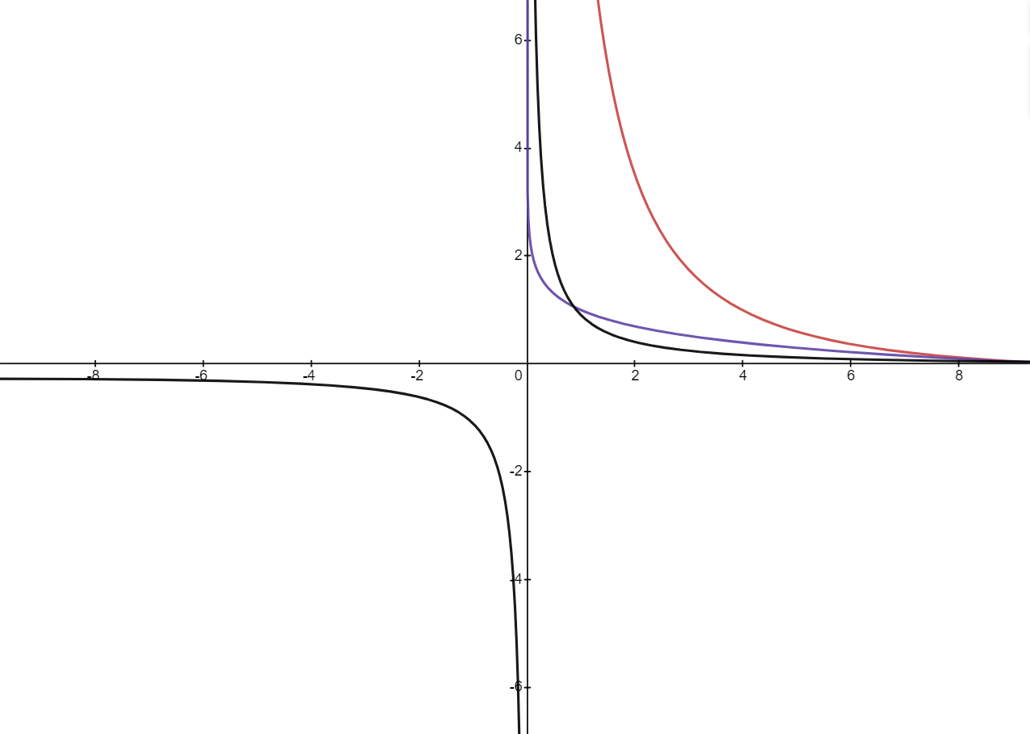

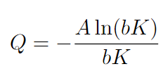
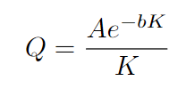
Intro
Potential 1(blue)
Potential 2(red)
Potential 3 (black)

Slide 3
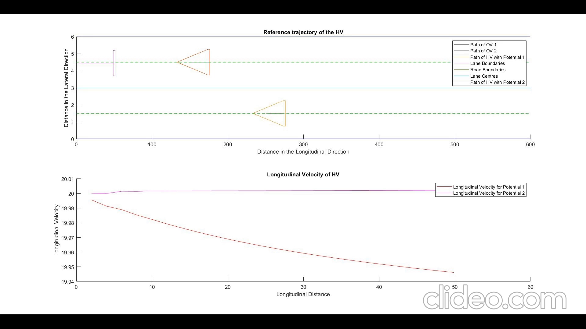

Slide 4
